Slide 1
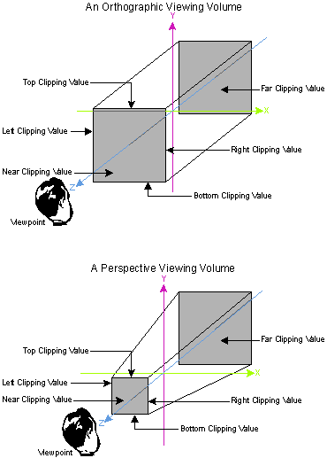
Computer GRaphics
Helmuth Trefftz - EAFIT

Slide 2
Agenda
Translation
Scaling
Rotations
Around X
Around Y
Around Z
Perspective

Slide 3
3D Transforms
Translations:

Slide 4
3D Transforms
Scaling:

Slide 5
3D Transforms
Scaling:
Just as in 2D, a scaling transform can also translate the object, if it is not in the origin of the Cartesian plane
This can be avoided by translating the object to the center, scaling and translating back to the original place

Slide 6
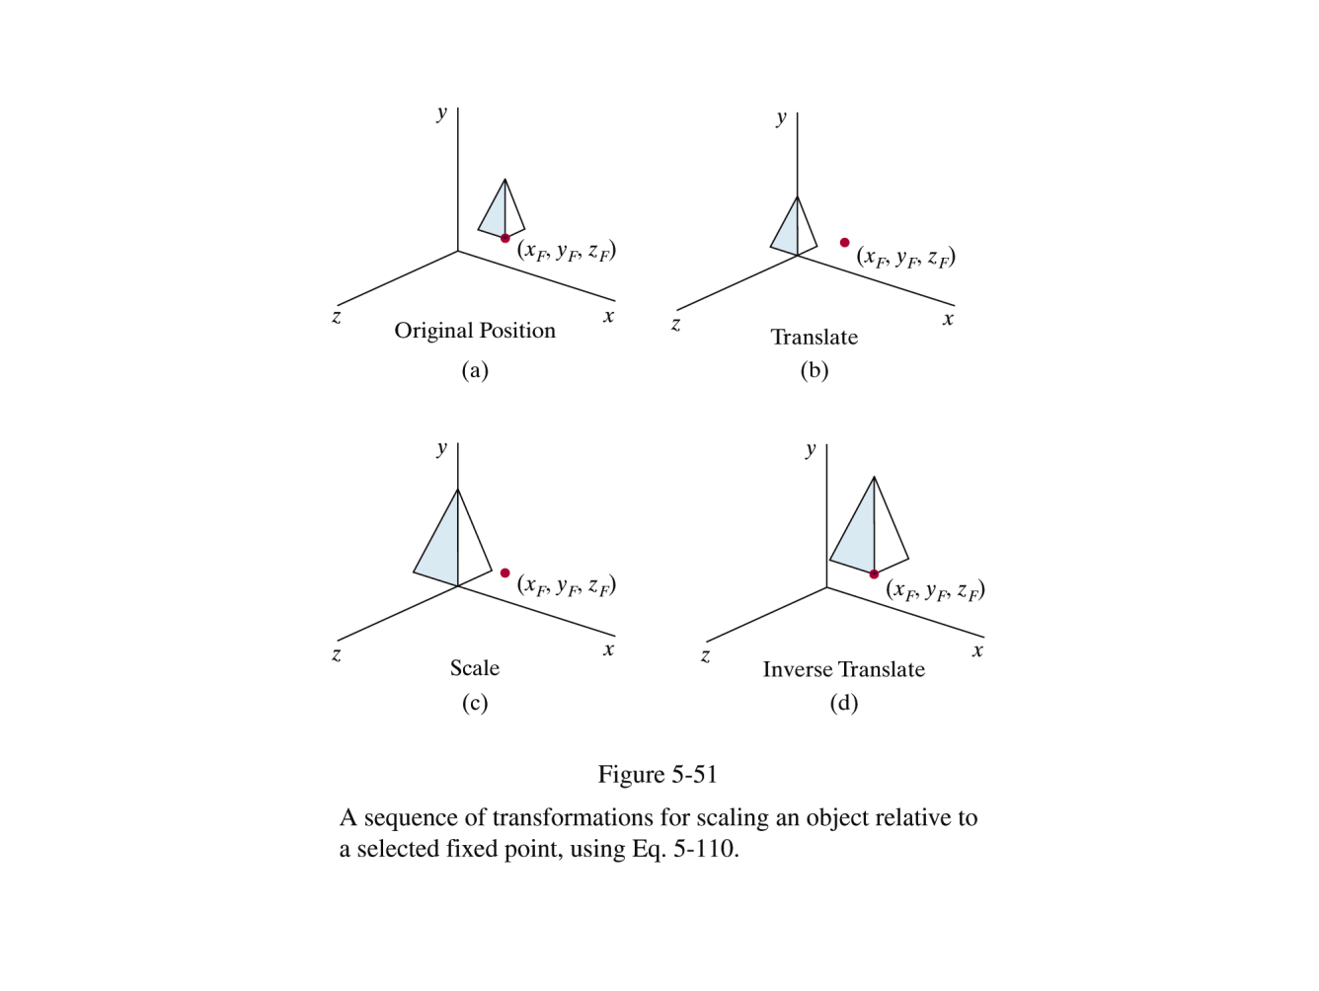
Combining 3D transforms
Scaling with a pivot point

Slide 7
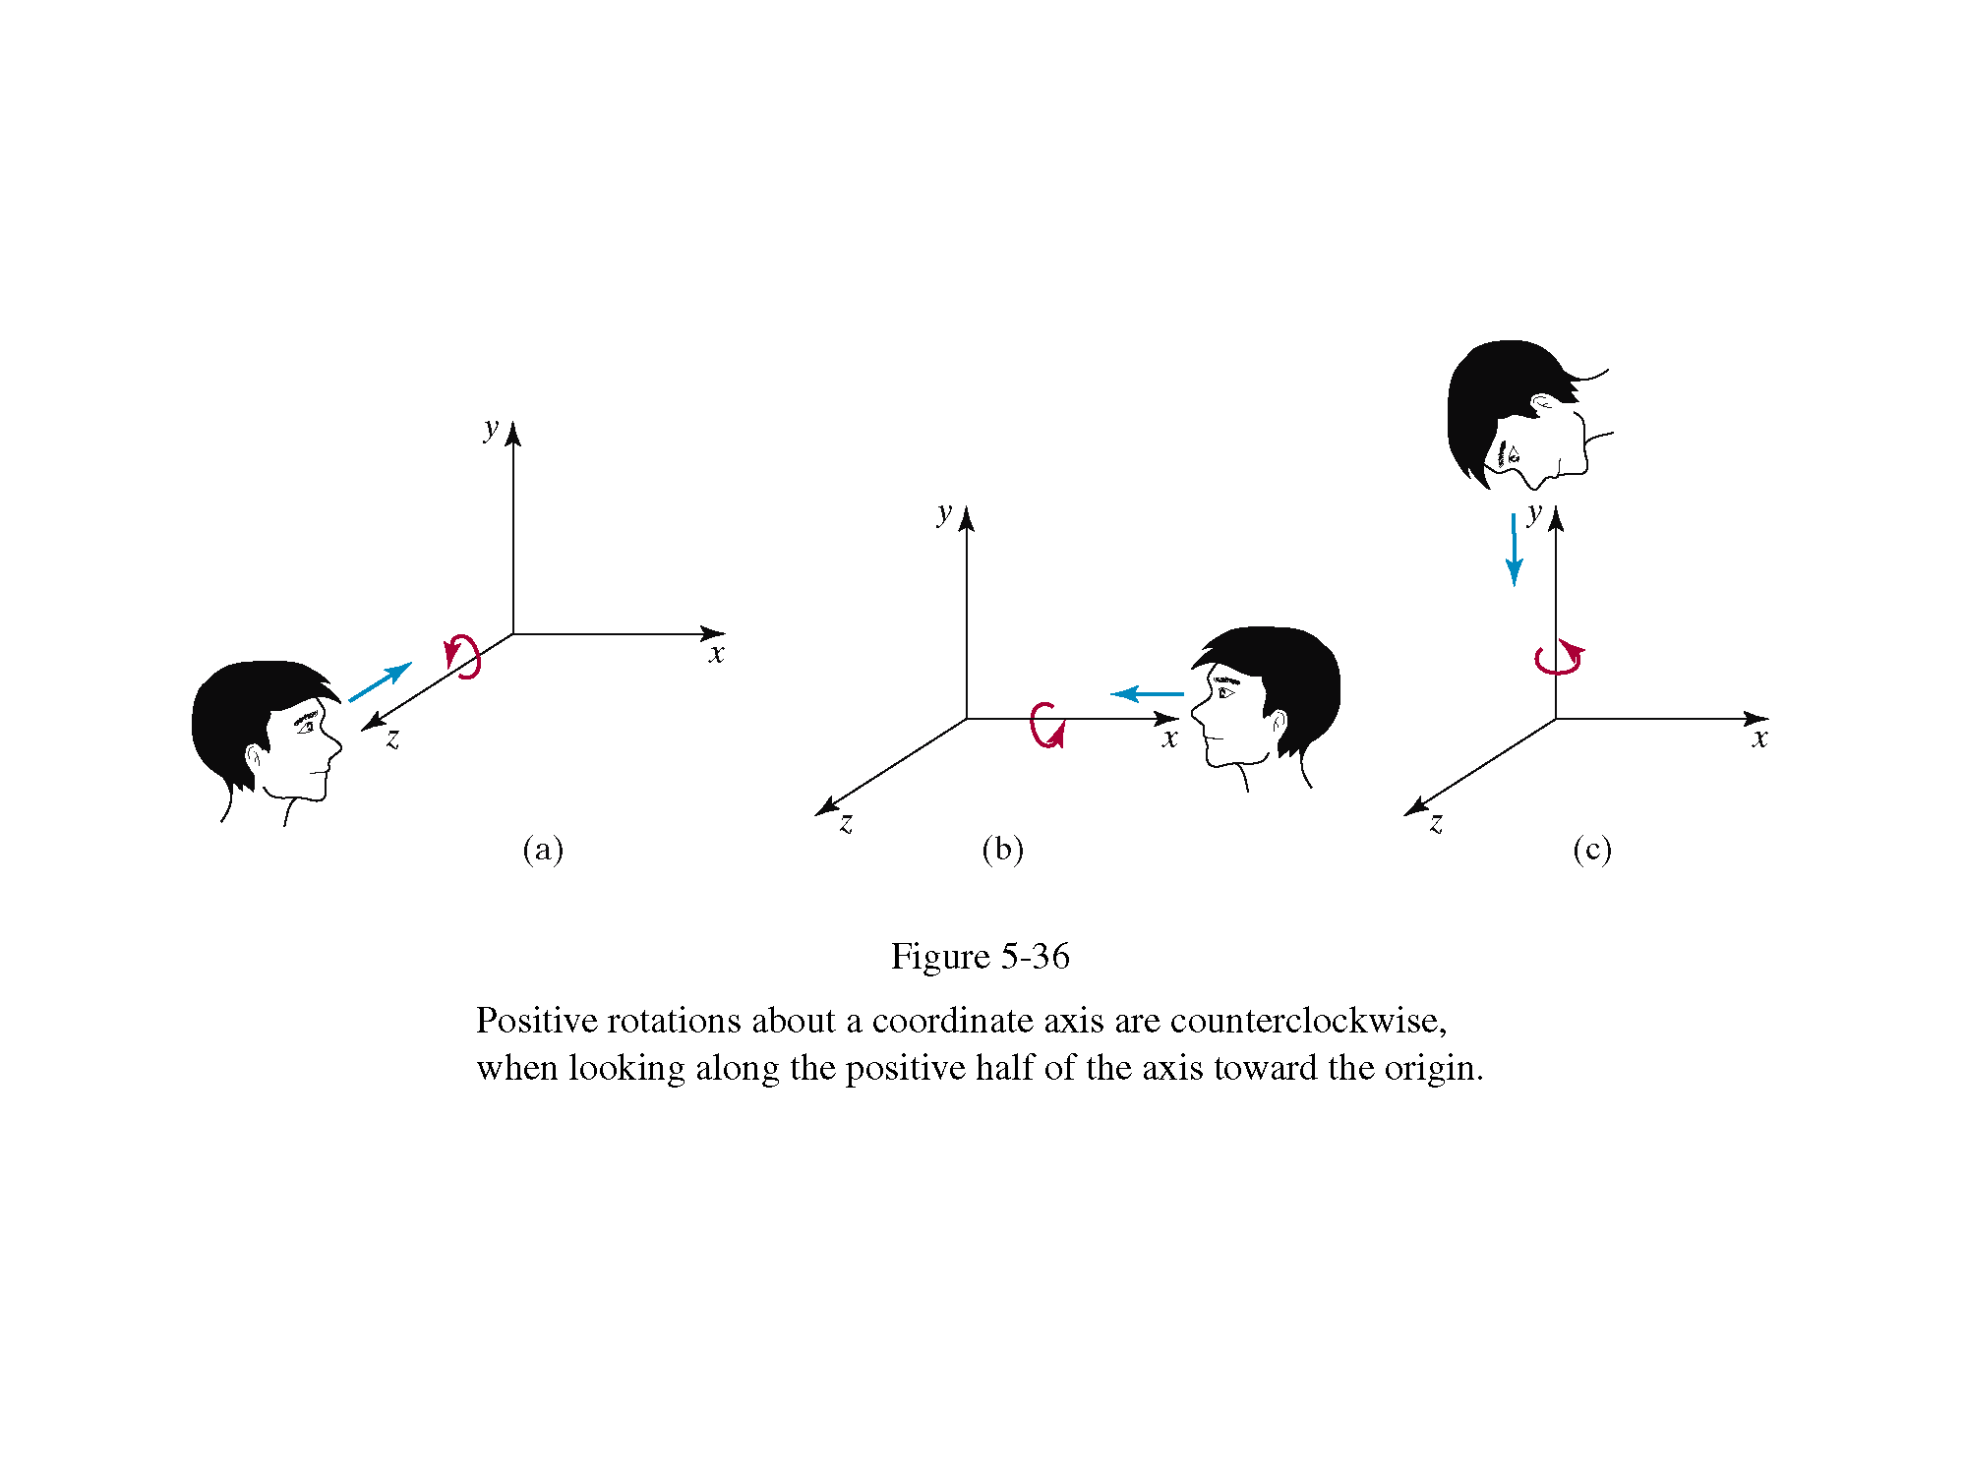
3D Rotations

Slide 8
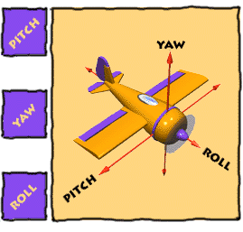
3D Rotations
Image Source: http://www.vrarchitect.net/anu/cg/Transformation/printNotes.en.html

Slide 9
3D Transforms
Rotation: The right-hand rule is used to determine the direction of the rotation.

Slide 10
3D Transforms
Rotation:
As in 2D, the object rotates around the origin.
In order to avoid unwanted translations, the object is translated to the origin, then rotated, and finally translated back to the original position

Slide 11
Inverse transforms
Inverse of T: change the signs of dx, dy and dz
Inverse of S: exchange sx, sy and sz by their reciprocals.
Inverse of R: change the sign of the angle

Slide 12
Combining 3D transforms
How to make a point in 3D rotate around an arbitrary axis?

Slide 13
Rotation around an arbitrary axis
y
P3 will rotate around the axis defined by P1P2
(i) Make a series of translations and rotations so that the axis P1P2 coincides with the z axis.
(ii) Rotate around z.
(iii) Apply the inverse of all transformations involved in step (i)
P3
P2
P1
X
Z
y
P3
P1
X
P2
Z

Slide 14
Step 1
Translate P1 to the origin:

Slide 15
Step 2
Y
Rotate around y axis so that P’1P’2 is on the YZ plane
Angle: -(90-θ) = θ – 90
P’3
P’2
P’1
θ
X
D1(x’2, 0, z’2)
Z

Slide 16
Step 3
Y
Rotate around the x axis so that P’’1P’’ coincides with the Z axis (note that P’’1P’’3 is not necessarily on the Yzplane):
P’’₃
y’’₂
P’’₂
P’’₁
φ
X
Z’’₂
Z

Slide 17
Step 4
Y
Rotate around the z axis the desired angle:
y’’’₃
α
P’’’₃
P’’’₁
X
x’’’₃
P’’’₂
Z

Slide 18
Final transform:
y
Complete transformation
Then undo the first transforms:
P3
P2
P1
X
Z
y
P3
P1
X
P2
Z

Slide 19
Other 3D Transformations
What does the following transformation do?
It converts from a right-hand system into a left-hand and vice versa

Slide 20
3D Shears
What does the following transformation do?
Shears the x and y coordinates as z increases.

Slide 21

Projection Transformations

Slide 22
Projection Transformations
Projections: project a 3D object into a flat, 2D surface
Types of projection:
Perspective
Parallel

Slide 23
Perspective
x
Projection plane: Orthogonal to the z axis, distance d from the origin.
P(x, y, z)
x_{p}
x
z
d
d
z
y_{p}
P(x, y, z)
y

Slide 24
Perspective
As matrix multiplication:
Dividing by W:

Slide 25
Perspective – For programming purposes
If the observer is at the origin, looking in the +Z direction, the X axis grows to the left of the viewport window.
It is simpler to put the observer in the origin, looking in the –Z direction.
In this case, put the object to draw along the –Z axis, and d becomes negative.
In this situation, X grows to the right of the viewport window.

Slide 26
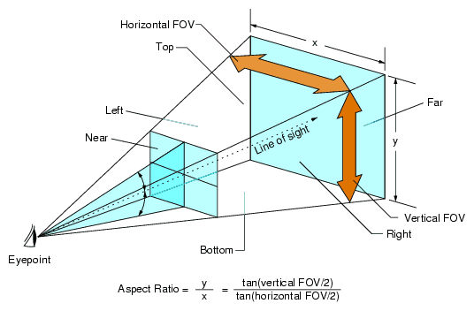
What FOV is normal?
The field of view angle corresponds to normal lenses?
Consoles: 60 degrees
PC: 90 to 100 degrees
Source: (2) and (3)

Slide 27
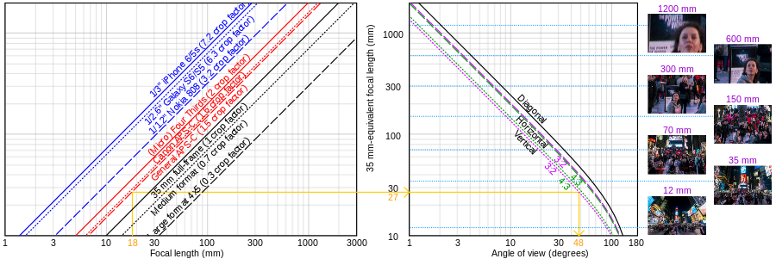
What FOV is “normal”?
Log-log graphs of focal length vs crop factor vs diagonal, horizontal and vertical angles of view for film or sensors of 3:2 and 4:3 aspect ratios. The yellow line shows an example where 18 mm on 3:2 APS-C is equivalent to 27 mm and yields a vertical angle of 48 degrees.

Slide 28
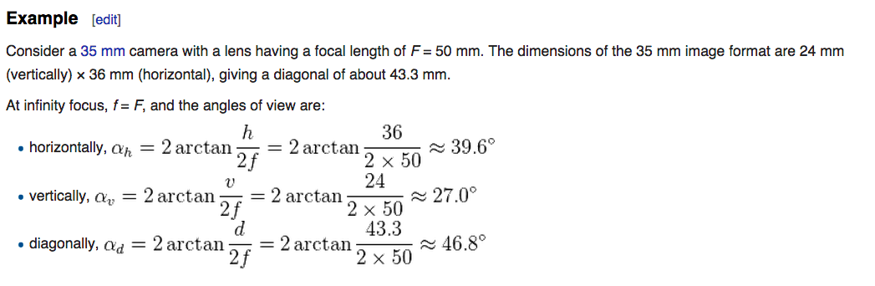
What FOV is “normal”?
From Wikipedia: Angle of View:

Slide 29
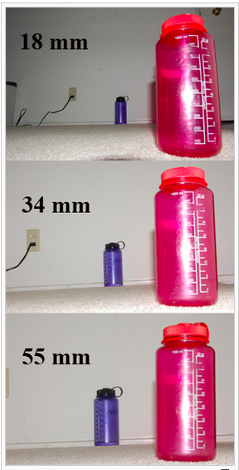
How Focal Lenth affects perspective

Slide 30
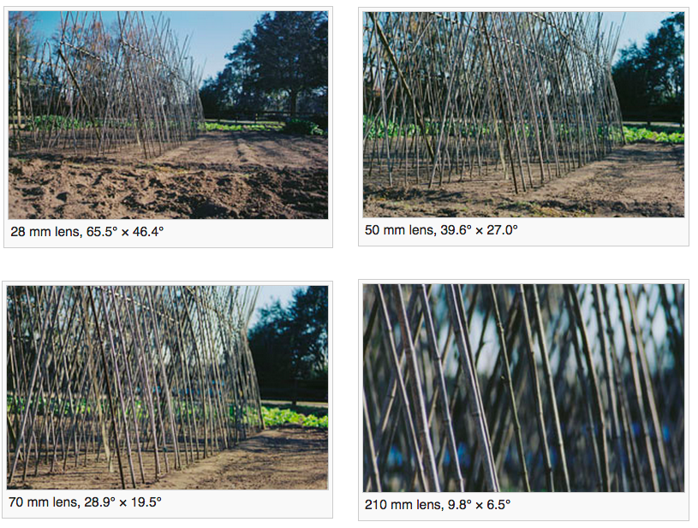
How lens choice affects FOV

Slide 31
Bibliography
(1) Reading: Hearn & Baker. Sections 5-9 to 5-16.
(2) http://en.wikipedia.org/wiki/Field_of_view_in_video_games
(3) http://en.wikipedia.org/wiki/Angle_of_view#Focal_length

Slide 32
Credits
FOV image:
http://www.incgamers.com/2013/05/why-good-fov-options-are-crucial-to-pc-games

